Slide 1
Quantifying the Ability of JWST to Detect Biosignatures.
Great Lakes Exoplanet Area Meeting 2022
Huihao Zhang
Research Advisor: Ji Wang

Slide 2
JWST allows us to discover the gases in the atmospheres of transiting planets
https://www.physics.uu.se/research/astronomy-and-space-physics
/research/planets/exoplanet-atmospheres/

Slide 3
The purpose of this research:
1. Exploring the detectability of JWST for gases in the Trappist-1e‘s potential atmosphere
2. Find a method that quantifies the detectability of JWST for biosignatures composed of multiple gases

Slide 4


Exoplanet data are from
https://exoplanetarchive.ipac.caltech.edu/
The open-source libraries used in the process
PICASO
PandExo

Slide 5
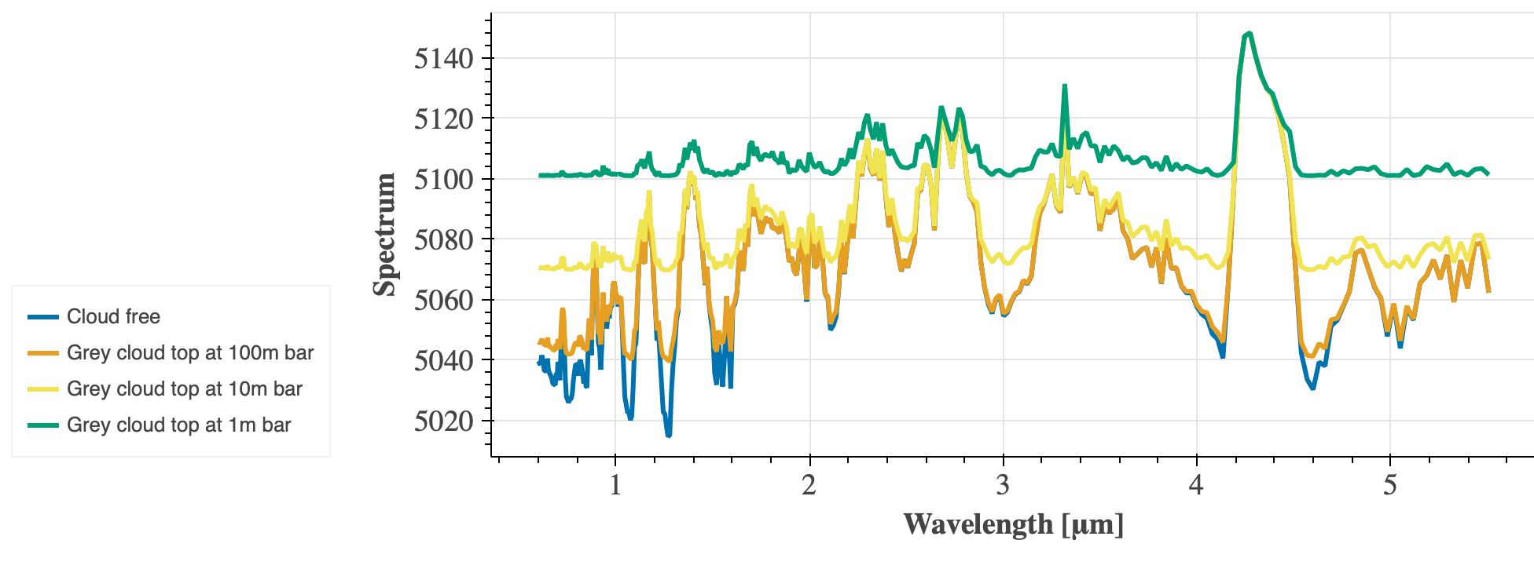
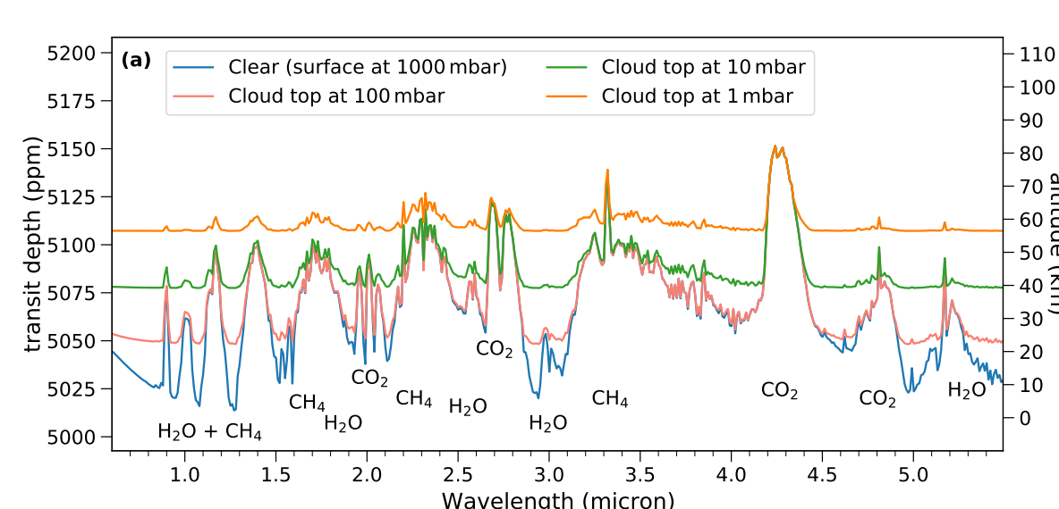
Transmission Spectrum
Modern Earth
CO2
Data similarity
CO2
CH4
H2O
H2O
CH4
H2O
H2O
CO2
CO2
CH4
> 95%
H2O+CH4
Spectrum generated by PICASO
Mikal-Evans, T., 2022.

Slide 6
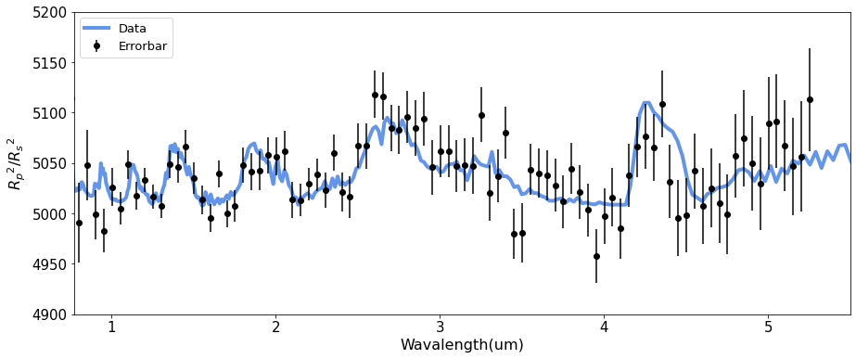
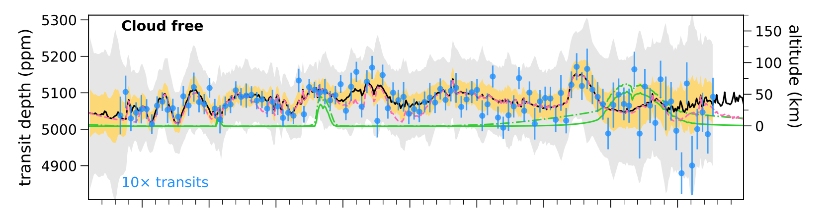
Simulated Data of JWST
Modern Earth
CO2
CO2
H2O
CO2
CO2
CH4
H2O
CH4
H2O
H2O
H2O+CH4
CH4
Spectrum generated by PandExo
H2O
CO2
CH4
H2O
CO2
H2O
CH4
CO2
H2O+CH4
CH4
CO2
H2O
1
2
3
4
5
Mikal-Evans, T., 2022.

Slide 7
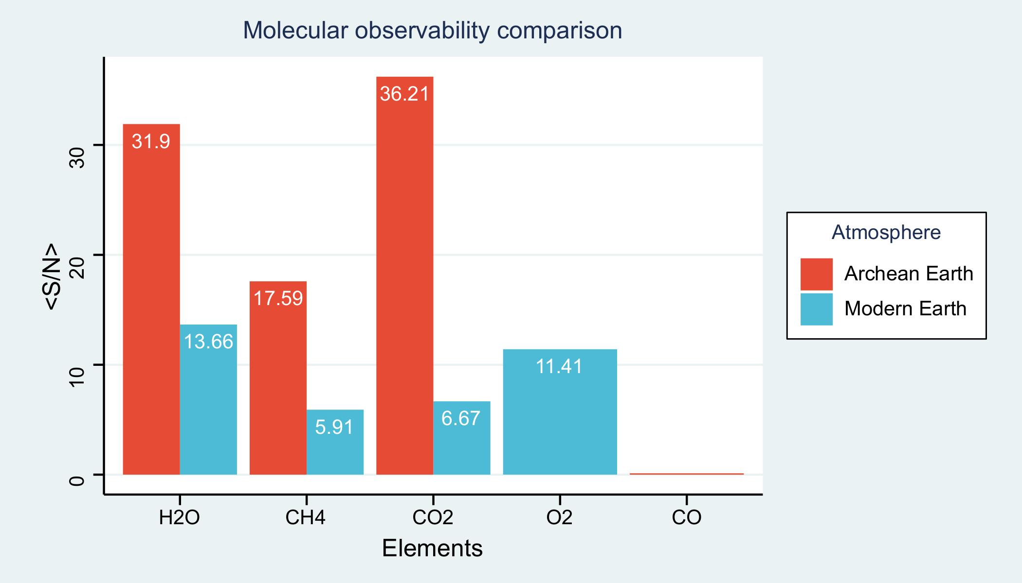
Detectability of Gases
Together as a Biosignature
In Archean Earth
Together as a Biosignature
In Modern Earth
Method for finding the feature wavelength(Phillips, et al. 2021. )
The detectability of biosignature gases in Archean Earth is higher than in Modern Earth except for CO.

Slide 8
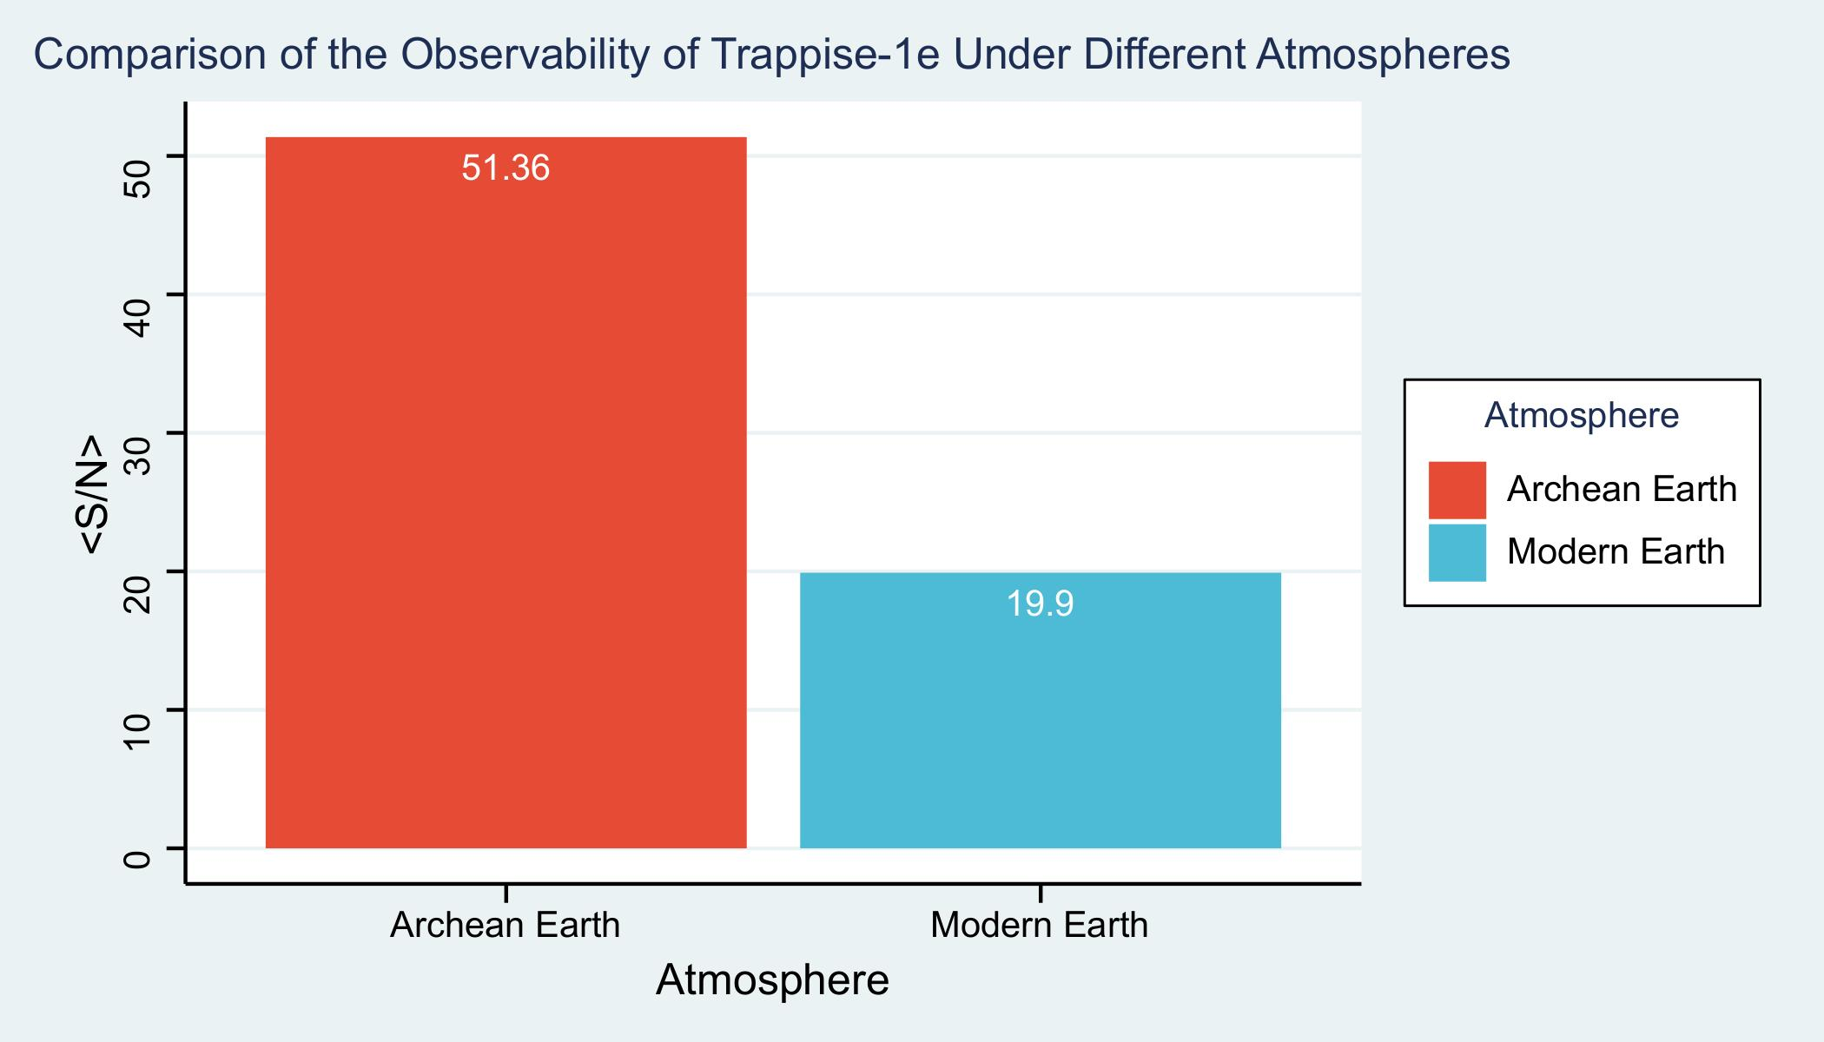
Detectability of Biosignature
H2O, CH4, CO2, CO
H2O, CH4, CO2, O2
The method does not apply in this case!
How to find the detectability of a biosignature composed of multiple gases?

Slide 9
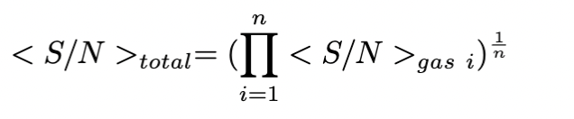


Detectability of Biosignature
We proposed an equation that can quantify the detectability of biosignatures.
For Archean Earth, the total <S/N> of CO2 + CH4 + H2O+CO:
$${<S/N>}_{total}$$
$${=({<S/N>}_{CO2}∙{<S/N>}_{CH4}∙{<S/N>}_{H2O}∙{<S/N>}_{CO})}^{1/4}$$
=7.03
For Modern Earth, the total <S/N> of CO2 + CH4 + H2O+O2:
$${<S/N>}_{total}$$
$${=({<S/N>}_{CO2}∙{<S/N>}_{CH4}∙{<S/N>}_{H2O}∙{<S/N>}_{O2})}^{1/4}$$
=8.85

Slide 10
Conclusion
Our results show that JWST can detect some biosignatures in the TRAPPIST-1e potential atmosphere.
We found a method that quantifies the detectability of JWST for biosignatures composed of multiple gases.

Slide 11
Thank you!
Report Over
Huihao Zhang
Research Advisor: Prof. Ji Wang

